Slide 1



AI-Based Credit Card Fraud Detection System
A smart, web-based platform that leverages artificial intelligence and real-time risk analysis to detect and prevent suspicious credit card transactions 4 before they cause harm.

Slide 2

What This System Does
This system combines AI-driven risk analysis with a modern web interface to monitor credit card transactions in real time. Instead of relying on slow, manual review processes, it automatically evaluates each transaction and flags suspicious activity 4 giving financial teams the speed and accuracy they need to act.

Slide 3


The Fraud Problem Is Growing
Online fraud cases are increasing rapidly, and manual verification methods are slow and inefficient.

Slide 4






Project Objectives
Four core goals drive this system's design 4 from detection to prevention.
Detect Fraudulent Transactions
Security
authentication and monitoring.
risk scoring.
Reduce Financial Losses
Minimize fraud-related losses by catching threats before
they escalate.
Provide Transaction Monitoring
dashboard and reporting tools.

Slide 5
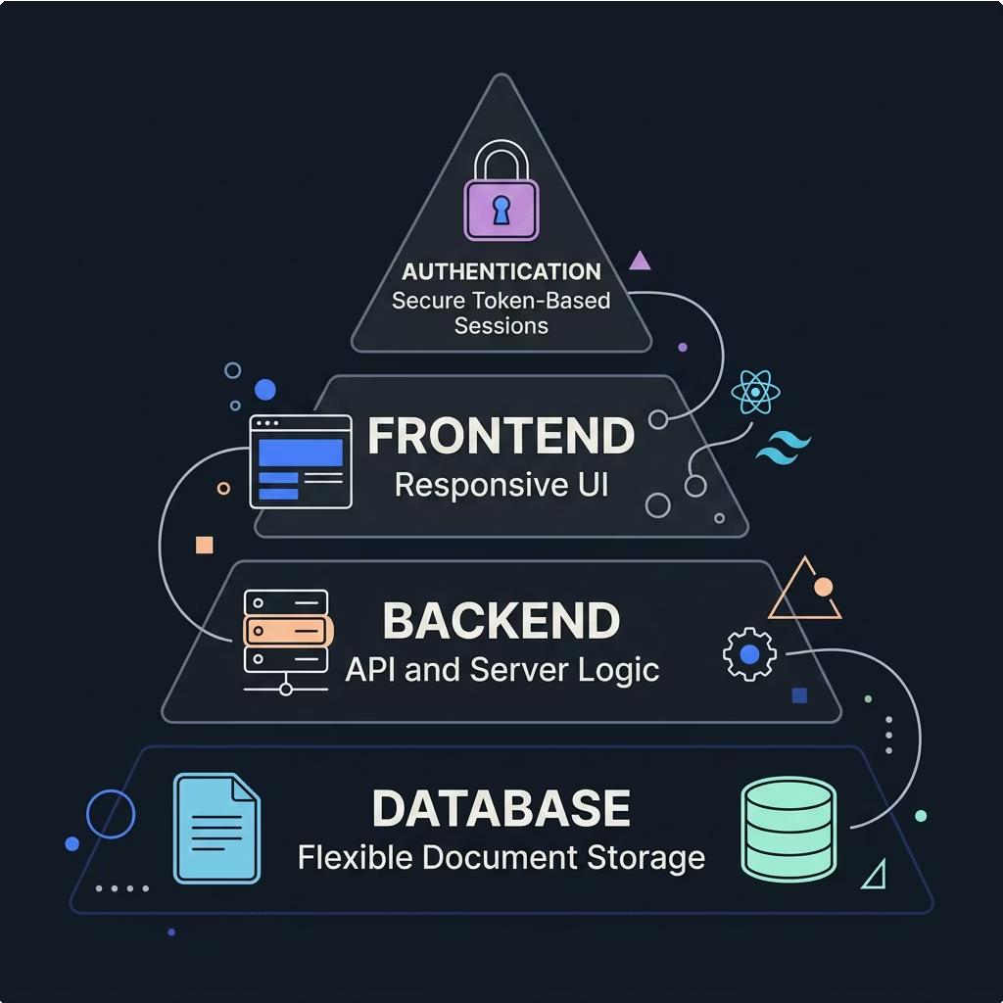

Technology Stack
A modern, full-stack architecture built for speed, scalability, and security.
React.js + Tailwind CSS
Responsive, component-driven UI with utility-first styling for rapid iteration.
MongoDB
Flexible document database ideal for storing transaction records and user data.
Node.js + Express.js
Lightweight, high-performance backend powering RESTful API services.
JWT Authentication
Stateless, token-based authentication ensuring secure, scalable session management.

Slide 6


System Modules
User Authentication
Secure login and session management via JWT tokens, protecting user
accounts and data access.
Transaction Management
Capture, store, and manage all transaction records with full audit trails and metadata.
Fraud Detection Engine
AI model analyzes transaction patterns and generates a real-time risk
score for each event.
Dashboard & Reports
Visual analytics and reporting tools giving stakeholders clear visibility
into fraud trends.

Slide 7







How It Works
From input to insight 4 the system processes each transaction through a streamlined, intelligent pipeline.
Classificatio n
User Input
AI Analysis
Store Results
Every transaction is evaluated in seconds, with results logged and surfaced instantly on the dashboard for review.

Slide 8





Key Features & Advantages
Real-Time Fraud Detection
Transactions are analyzed instantly, enabling immediate action on suspicious activity.
Secure Login
JWT-based authentication ensures only authorized users access sensitive data.
Risk Score Generation
Each transaction receives a clear, interpretable risk score to guide decision-making.
Faster, Efficient Monitoring
Automated analysis replaces slow manual reviews, freeing teams to focus on high- priority alerts.

Slide 9





Future Scope
The roadmap extends the system's capabilities from a standalone tool to a fully integrated financial security platform.
Banking API Integration
Connect directly with banking systems for live transaction feeds and enriched data.
Advanced ML Models
Upgrade to deep learning models for higher accuracy and adaptive fraud pattern recognition.
SMS & Email Alerts
Proactively notify users and analysts when high-risk transactions are detected.
Mobile Application
Extend monitoring and alerts to a native mobile app for on-the-go oversight.

Slide 10
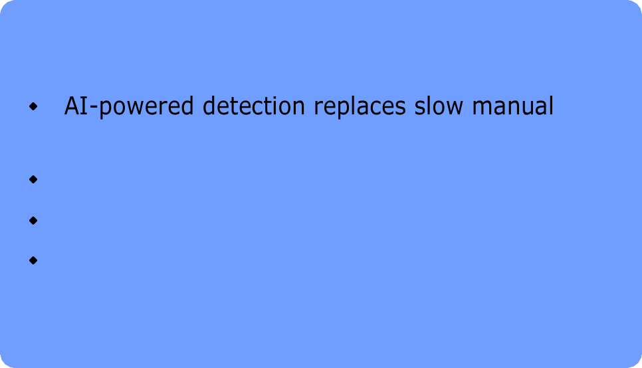


Conclusion
This system delivers a secure, intelligent, and scalable solution for detecting fraudulent credit card transactions. By combining AI- driven risk analysis with a modern full-stack architecture, it addresses the core challenges of speed, accuracy, and financial protection in digital payments.
A proactive approach to fraud detection 4 protecting
customers and institutions before losses occur.
Key Takeaways
processes
Real-time risk scoring enables faster decisions Modular architecture supports future growth End-to-end security from login to reporting

